Slide 1



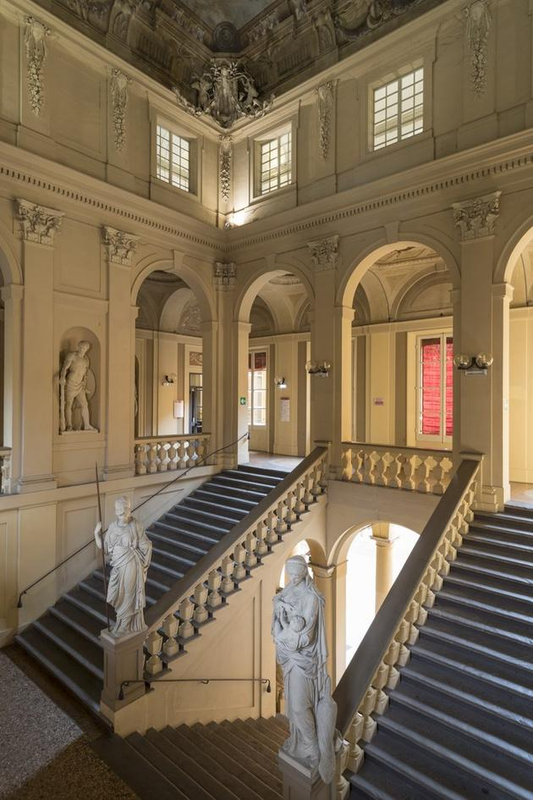

Welcome to the
MASTER’S DEGREE in
INTERNATIONAL RELATIONS
ALMA MATER STUDIORUM
UNIVERSITÀ DI BOLOGNA
September 17th, 2025

Slide 2
Welcome to the IR Introduction Days!
DAY 1 - September 17th: Getting started
Important contacts
Academic calendar 2025/26
Structure of the course
Study plan: what, when & how
Special focus: workshops, tracks
One degree, countless opportunities: your tutor’s testimonies
Q&A
DAY 2 - September 24th:
- Study abroad,
- Internships
- IR-JHU partnership
- Final thesis

Slide 3
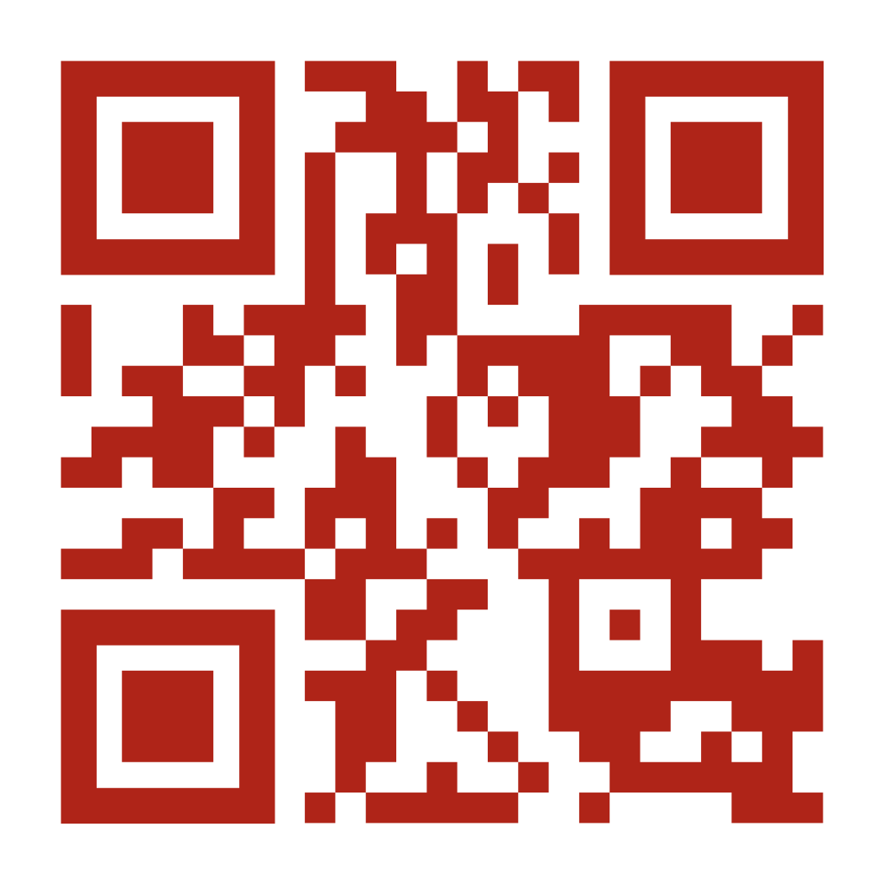
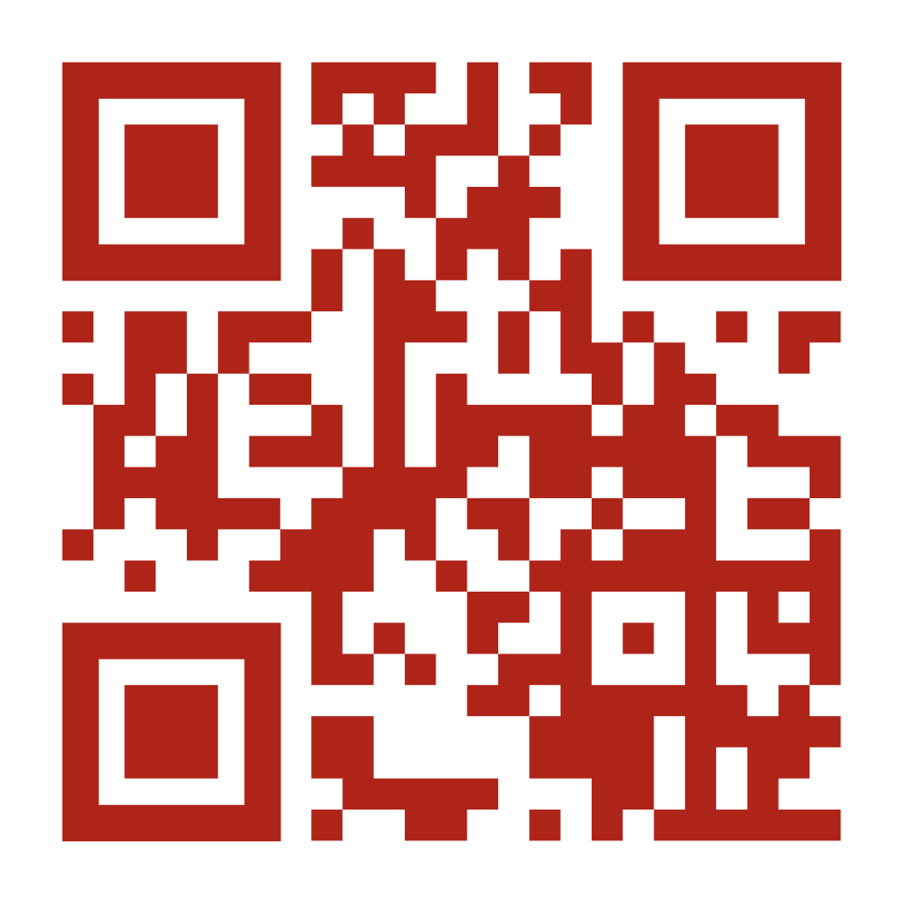
Check out our website!
https://corsi.unibo.it/2cycle/InternationalRelations
https://corsi.unibo.it/2cycle/InternationalRelations/notice-board
PRO TIP: If you have any doubt, always double-check on our official website - most of the time, all information can be found there :)
Always monitor the IR notice board to stay up to date! Most opportunities will be advertised here (Erasmus+, overseas, call for applications, etc.), as well as events held at the Department of Political and Social Sciences!

Slide 4
Important contacts
Degree Programme Director & curriculum IA contact, Prof. Massimiliano Trentin – massimiliano.trentin@unibo.it
Degree Programme Administrative Desk– didatticahercolani.rilm@unibo.it
Contact Person for Curriculum European Affairs (EUA), Prof. Elena Baracani – elena.baracani@unibo.it
Contact Person for Curriculum Crime, Justice and Security (CJS), Prof. Anita Lavorgna – anita.lavorgna@unibo.it
Degree Tutor, Anita Artusi anita.artusi2@unibo.it
International Tutor, Anna Fontana anna.fontana9@unibo.it

Slide 5
Important contacts
Student Administration Office – segscpol@unibo.it
General enquiries on enrolment, fees, changes and transfers, degree, diploma supplements.
International Student Administration Office – segstudintbo@unibo.it
Enquiries for students with foreign qualifications – e.g., submitting documents and completion of matriculation to degree programmes in Bologna.
Know who to contact: before sending an email, always read our contact page first and make sure you’re writing to the right person/office!
More contacts on our website.
You can also start a request to contact the Offices through StudentiOnline!

Slide 6
Academic calendar 2025/2026
1st SEMESTER | From Monday 15/09/2025 to Friday 19/12/2025 | From Mon 27/10/2025 to Fri 31/10/2025 (no academic activities)
CHRISTMAS BREAK | From Wednesday 24/12/2024 to Tuesday 06/01/2025
WINTER EXAM SESSION | From Wednesday 07/01/2026 to Friday 13/02/2026
2nd SEMESTER | From Monday 16/02/2026 to Friday 05/06/2026 | From Mon 23/03/2026 to Fri 27/03/2026 (no academic activities) From Thur 02/04/2026 to Tue 07/04/2026 (Easter holidays) Friday 01/05/2026 (Labour Day)
SUMMER EXAM SESSION | From Monday 08/06/2026 to Friday 31/07/2026
SUMMER BREAK | From Monday 03/08/2026 to Friday 21/08/2026
(LATE) SUMMER EXAM SESSION | From Monday 24/08/2026 to Friday 11/09/2026
LECTURES
EXAMS
BREAKS
PUBLIC HOLIDAYS
Download

Slide 7
Study plan
WHAT is my study plan?
  The list of learning activities (courses) that a student has to complete for the achievement of the degree.
WHEN can I modify my study plan?
  You can modify your study plan ONLY during the relevant timeframes for the a.y. 2025/2026
    1st timeframe: 29 September – 1 November 2025
    2nd timeframe: 7 – 23 January 2026 (reserved exclusively for first-year students)
    3rd timeframe: 2 February – 20 March 2026
  IMPORTANT: After the deadlines, the last study plan presented will be deemed as valid and you will no longer be able to make amendments. This means that, outside of these timeframes, you CANNOT modify your study plan!

Slide 8
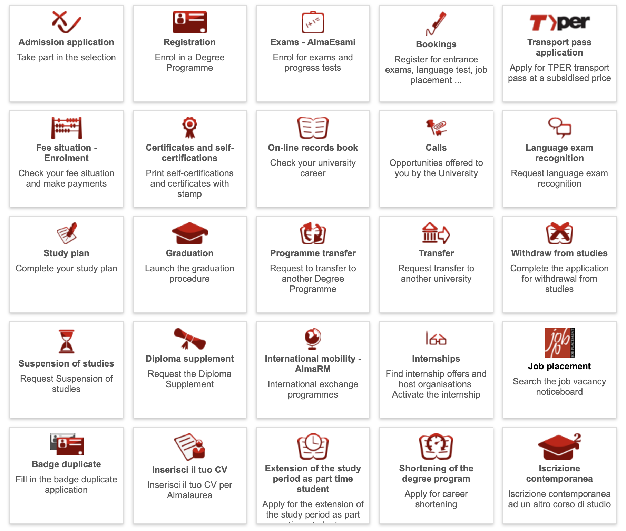
Study plan

Slide 9
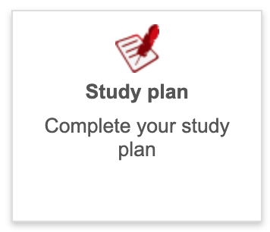
Study plan
HOW do I modify my study plan?
  Go to Studenti.Online
> Log in with your Unibo credentials
> Select “Study Plan”
> Select your career “International Relations”
> Select the courses you want to include in your study plan
> Confirm: present your study plan
Once you have presented/confirmed your study plan, you will be able to download your study plan.
More on how to prepare your study plan on our website. For further questions, please contact the LM IR Desk at didatticahercolani.rilm@unibo.it

Slide 10
Structure 2025/26 - YEAR 1 (60 CFU/ECTS)
Y E A R 1 | International Affairs | European Affairs | Crime, Justice, and Security
 | Evolution of the International System (8 CFU)
 | Research Methods (8 CFU)
 | Political Science field - 1 among listed courses (8 CFU) | Politics of European Institutions (8 CFU) | Politics of Collective Violence (8 CFU)
 | History field - 1 among listed courses (8 CFU) | The EU as a Global Actor (8 CFU) | History of Globalisation and Crime (8 CFU)
 | 1 Elective/free course among the IR courses (8 CFU) | EU Constitutional Law (8 CFU) | Sociology field - 1 among listed courses (8 CFU)
 | Economics field - 1 among listed courses (8 CFU)
 | Sociology field (8 CFU)
 | Data Science Workshop (4 CFU)
Compulsory courses
Elective courses
Language course
Workshop
CFU = ECTS

Slide 11
Structure 2025/26 - YEAR 2 (60 CFU/ECTS)
Y E A R 2 | International Affairs | European Affairs | Crime, Justice, and Security
 | Final test/examination (24 CFU)
 | Workshop (4 CFU)
 | History field - 1 among listed courses (8 CFU) | 1 among listed courses (8 CFU) | 1 among listed courses (8 CFU)
 | 1 among listed courses (8 CFU) | 1 among listed courses (8 CFU) | 1 among listed courses (8 CFU)
 | 1 among listed courses (8 CFU) | 1 among listed courses (8 CFU) | 1 among listed courses (8 CFU)
 | Free credits – electives among the Political Science department, internship(s), JHU elective course, etc. (8-16 CFU)
Master’s Thesis
Elective courses
Free credits
Workshop
CFU = ECTS
More on the structure of each curriculum.

Slide 12
Workshop (4 CFU)
Workshop
Professionalising activities, smaller classes, interactive structure, mandatory attendance
1 Workshop = 4 CFU, 20 hrs
No grade: Pass/Fail
During your two years at IR, you will follow 2 workshops (one per academic year):
  1st year: Workshop centered on
  2nd year: another Workshop of your choice among those available:
DATA SCIENCE
ADVANCED DATA SCIENCE
EU FOREIGN POLICY ANALYSIS
REPORT WRITING
VISUAL ETHNOGRAPHY

Slide 13
International Affairs curriculum: Tracks
Disclaimer: TRACKS ≠ CURRICULUM!
  Tracks are NOT binding/mandatory - unlike the curriculum you chose (i.e. IA, EUA, CJS)
  Tracks are a set of suggested courses recommended by the IR Study Board. You may decide to attend these courses to give more coherence to your study plan; but it’s totally up to you.
Here is the list of recommended TRACKS:
  TRACK 1: SECURITY STUDIES
  TRACK 2: CYBER AFFAIRS
  TRACK 3: DATA & ENVIRONMENT STUDIES FOR IR
  Find out more in the “Preparing the study plan” page of our website.

Slide 14
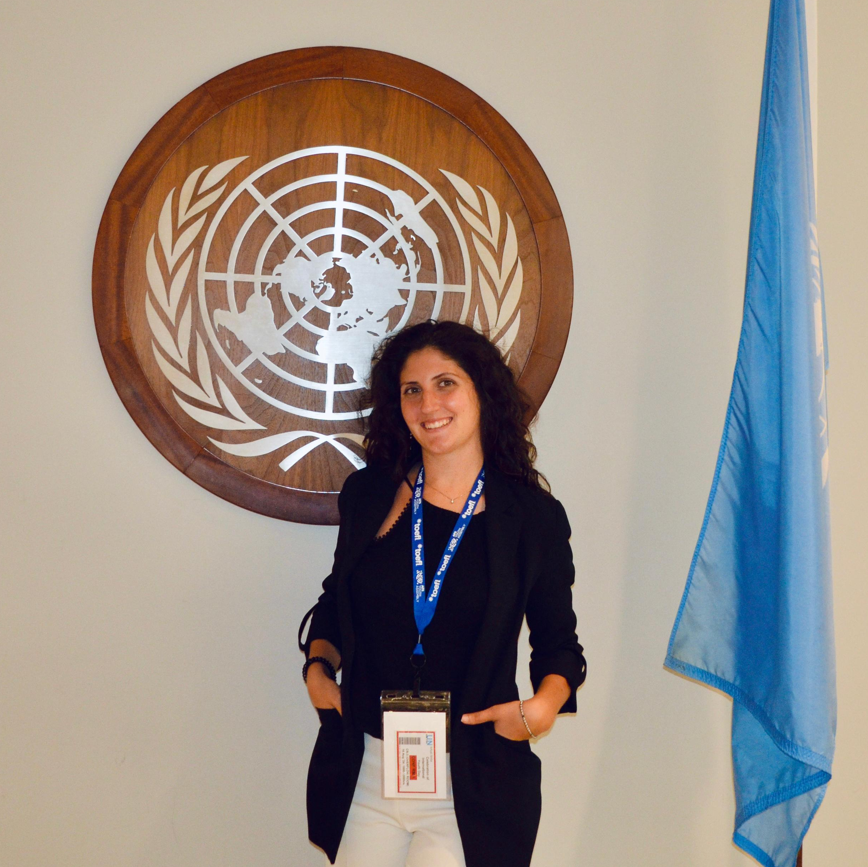
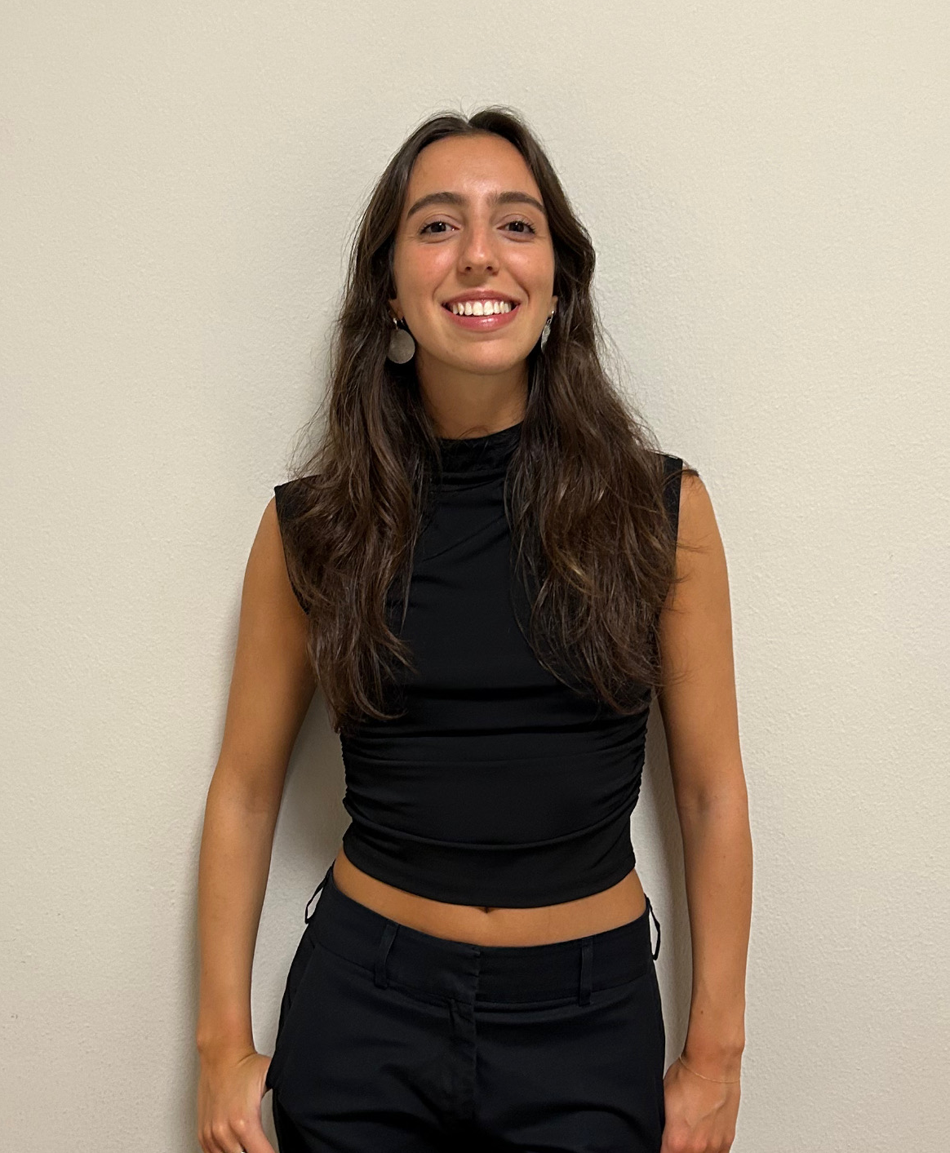
One degree, countless opportunities!
Hear it from your tutors, Anita & Anna!
Anita, Tutor of the Course
Anna, International Tutor
Send us an email at anita.artusi2@unibo.it & anna.fontana9@unibo.it

Slide 15
Meet our Tutors!
You will have the possibility to discuss your doubts about the study plan, courses, exams etc. with our Tutors on
October 7th, 2025 from 3:30 pm to 4:30 pm on Teams.
Find more info on the website's Notice Board.

Slide 16


Slide 17
NEXT TIME
on September 24th:
Study abroad, internships
UNIBO-JHU partnership, final dissertation
Master’s Degree in International Relations
didatticahercolani.rilm@unibo.it

Slide 18
Welcome to the
MASTER’S DEGREE in
INTERNATIONAL RELATIONS
ALMA MATER STUDIORUM
UNIVERSITÀ DI BOLOGNA
September 24th, 2025

Slide 19
Welcome to the IR Introduction Days!
DAY 2 - September 24th:
- Study abroad,
- Internships
- IR-JHU partnership
- Final thesis

Slide 20


Study abroad
Erasmus+
Spend from 3 up to 12 months at another European partner university
Application period: around January-February 2026
Overseas
Spend 1 or 2 semesters at a non-European partner university
Application period: around October 2025 (soon!)
For questions regarding the Erasmus+ and Overseas programmes, contact the International Mobility Office (mobility.politicalscience@unibo.it).
More on Erasmus+, Overseas, and other study abroad opportunities.

Slide 21
Internships
During your second year, you may carry out an internship as part of your free credits or in
preparation of your thesis. There are different types of internship you can insert in your study plan:
Curricular internship (8 CFU) - free credits
Internship abroad (8 CFU) - free credits
Internship in preparation of the final examination (12 CFU)
IMPORTANT: Follow the administrative procedures! If you want to earn credits for your internship, you must follow specific procedures in coordination with the relevant offices. You may not be able to start your internship if you do not contact the relevant offices on time!
More on internships.
Notes:
Internship opportunities sponsored by Unibo: tirocini.unibo.it

Slide 22
1) Curricular internship
8 CFU, max. 200 hours
In your study plan, “Tirocinio LM”
In Italy or abroad
No specific application period: you find the internship yourself and ask the Traineeship Office to activate it once you’ve been selected.
Contact the Traineeship Office of the Dept of Political and Social Sciences, spbo.tirocini@unibo.it

Slide 23
2) Internship abroad
8 CFU, max. 200 hours
In your study plan, “Tirocinio all’estero LM”
Abroad
No specific application period: you find the internship yourself and ask to activate it, once you’ve been selected
Contact the Traineeship Office of the Department, spbo.tirocini@unibo.it
Erasmus+ traineeship:
  Two- or three-month internship abroad, in another EU/partner country
  Funded by Erasmus+ grant
  Application period: around April-May 2026
  Contact the International Mobility Office, mobility.politicalscience@unibo.it
  You may conduct an Erasmus+ traineeship either as a student or as a recent graduate, i.e., after graduating.

Slide 24

2) Internship abroad (cont.)
Example: Tirocini MAECI-CRUI
  Internship at an Italian diplomatic representation: Embassy, Consulate, Permanent representation at an international organisation (UN, EU, OSCE, etc.)
  ONLY for Italian nationals
  3 calls for application per year
  Very popular among IR students and Unibo students in general!
  More information on the official website of the Fondazione CRUI.
  Contact the Traineeship Office of the Department, spbo.tirocini@unibo.it

Slide 25
3) Internship abroad in preparation of final examination
12 CFU, equivalent to 300 hours
ONLY abroad! Internships conducted in Italy do not qualify.
No specific application period: you find the internship yourself and ask to activate it, once you’ve been selected.
IMPORTANT: your thesis supervisor must approve the internship, before your start it!
Contact the Traineeship Office of the Department, spbo.tirocini@unibo.it

Slide 26
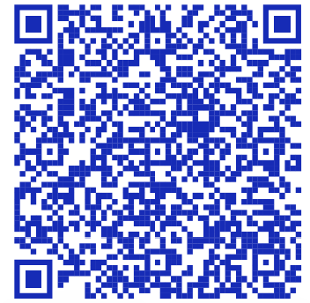

UNIBO-Johns Hopkins University partnership
Our Master course has established a collaboration with the Johns Hopkins’ School of Advanced International Studies (SAIS), one of the top graduate schools for international relations.
As An IR student, you may:
Apply for the IR-MAIA double degree programme
Follow a single course unit at SAIS
More on the Unibo-JHU partnership.

Slide 27
1) IR-MAIA double degree
1st year: IR Programme at Unibo (Bologna campus)
2nd year: MAIA Programme at JHU SAIS Europe (Bologna campus)
  MAIA = MA in International Affairs
A dedicated info session will be organised asap (October 2025)!
At the end of the two years, you obtain both a MA in International Affairs from the Johns Hopkins University and “Laurea Magistrale” in International Relations from the University of Bologna.
If you are selected, you may apply for financial aid
Johns Hopkins’ Admission Office: sais.eu.admissions@jhu.edu

Slide 28
2) JHU single course unit
Take a single course unit/exam at JHU SAIS from a set of available courses.
You will be able to insert the course into your Unibo study plan, as part of your free credits.
Application period: Winter 2025-26
For further information, contact the LM IR Desk, didatticahercolani.rilm@unibo.it

Slide 29
Thesis (24 CFU or 12+12 CFU)
Master’s Thesis
In your study plan, your final Master dissertation (thesis) is called “Final test” or “Final examination”
Your final thesis can be worth
  either 24 CFU
  or 12 + 12 CFU
    You can divide the thesis credits in two, if you wish to conduct a recognised* internship in preparation of your final dissertation or if you want to prepare your thesis abroad (through an Erasmus+ study grant or the Overseas programme)
More on our website: “Modalities and Guidelines” and “Graduation and final examination”.
NB. A specific info session on this topic will be organised later in the year.
*recognised internship = an internship that has been approved by the Traineeship Office and your thesis supervisor.

Slide 30
Final tips!
Have a look at the previous calls for application(Erasmus, overseas, grants, etc.) to get an idea
of the requirements and the application period. Previous calls can usually be found at bandi.unibo.it.
Always follow the administrative procedures, especially when it comes to internships!
Before sending us an email, always visit the IR official website first; most of the time, all information can be found there :)
Know who to contact: before sending an email, always read our contact page first and make sure you’re writing to the right office!
Always monitor IR notice board to stay up to date! Most opportunities will be advertised here (Erasmus+, overseas, call for applications, etc.), as well as events promoted by and held at the Department of Political and Social Sciences!

Slide 31

Don’t panic,
we're with you throughout your academic journey!
unibo.it/dontpanic
Making your study more effective
Coping with emotional challenges
Finding financial support
Affirming your identity
Finding protection from gender-based violence
Support for special educational needs
Balancing studies and a professional sports career
Balance study and work
Studying while caring for a loved one
At every stage of your academic journey,
you'll find people ready to support you.

Slide 32
Meet our Tutors!
You will have the possibility to discuss your doubts about the study plan, courses, etc. with our Tutors on
October 7th, 2025 from 3:30 pm to 4:30 pm on Teams.
Find more info on the website's Notice Board.

Slide 33
THANK YOU
&
GOOD LUCK WITH YOUR STUDIES!
Master’s Degree in International Relations
didatticahercolani.rilm@unibo.it

